Slide 1
Search Technology – Group 2
sergeyj@ifi.uio.no

Slide 2
countdown
Science Fair topic deadl. Today
Toronto 1 day
Assignment E deadline 10 days (next Friday)
Science Fair 16 days (just over 2 weeks)
Mock exam 23 days (just over 3 weeks)
Real exam 28 days (4 weeks)

Slide 3
Today’s Agenda
The trip to and from Toronto!
Naive Bayes walkthrough + Assignment E
Book of the week

Slide 4
toronto
ca. 6 days in Toronto!
ca. 1^{½} days on planes/in airports :)))

Slide 5
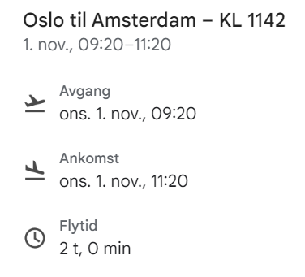
To toronto

Slide 6
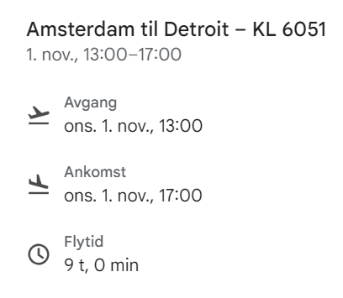
To toronto

Slide 7
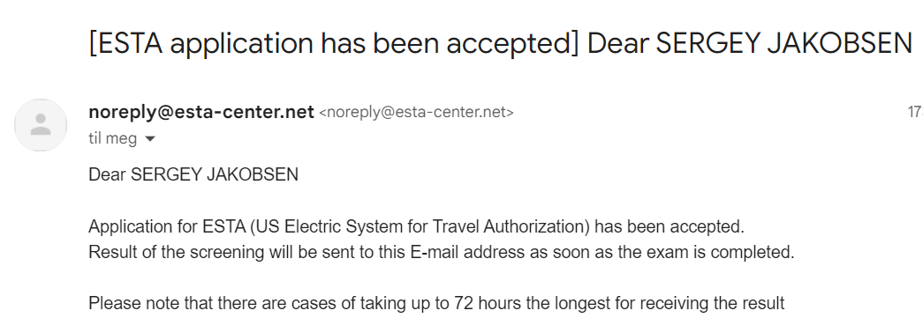
To toronto

Slide 8
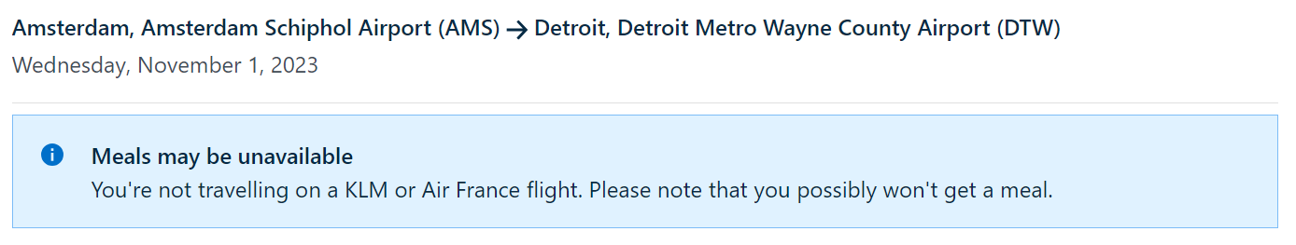
To toronto

Slide 9
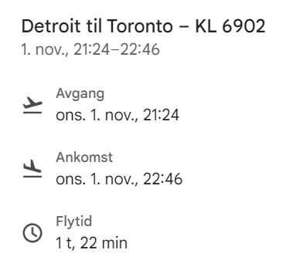
To toronto

Slide 10
To toronto

Slide 11
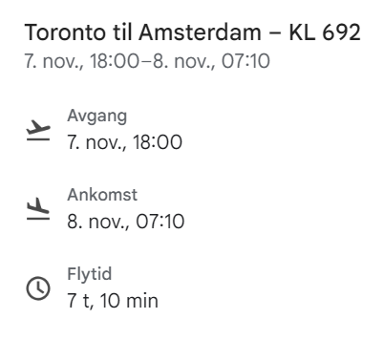
from toronto

Slide 12
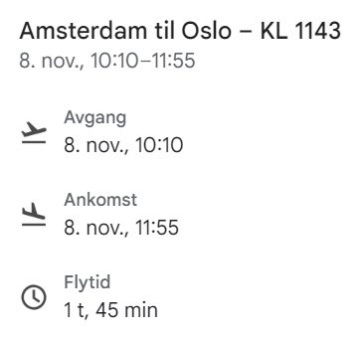
from toronto

Slide 13
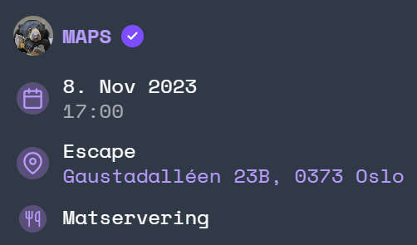
from toronto

Slide 14
Today’s Agenda
The trip to and from Toronto!
Naive Bayes walkthrough + Assignment E
Book of the week

Slide 15
Assignment e
Implementing a classifier for language detection
Naive Bayes
naivebayesclassifier.py

Slide 16
Naive bayes??
Machine learning algorithm
"Naive" because it doesn’t consider terms’ position

Slide 17
Library example
We made bank from our IT jobs after we graduated
Oliver got so rich he installed a library in his home, pre-filled with books

Slide 18
Library example
One day, he picks up one of the books, but doesn’t understand the language!
But, since his brain is wired with Naive Bayes, he can make a guess!

Slide 19
The entire library
His guess is based on the other books in the library

Slide 20
The entire library
He quickly opens all of them and notes down their words
def __compute_vocabulary(self, training_set, fields):

Slide 21
The entire library
Iterate training_set, corpus, fields, and terms in fields
Add terms to self.__vocabulary

Slide 22
Computing priors
def __compute_priors(self, training_set) -> None:

Slide 23
Computing priors
Oliver’s library contains books of 3 languages!

Slide 24
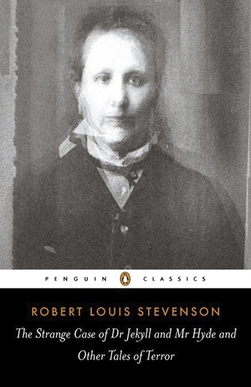

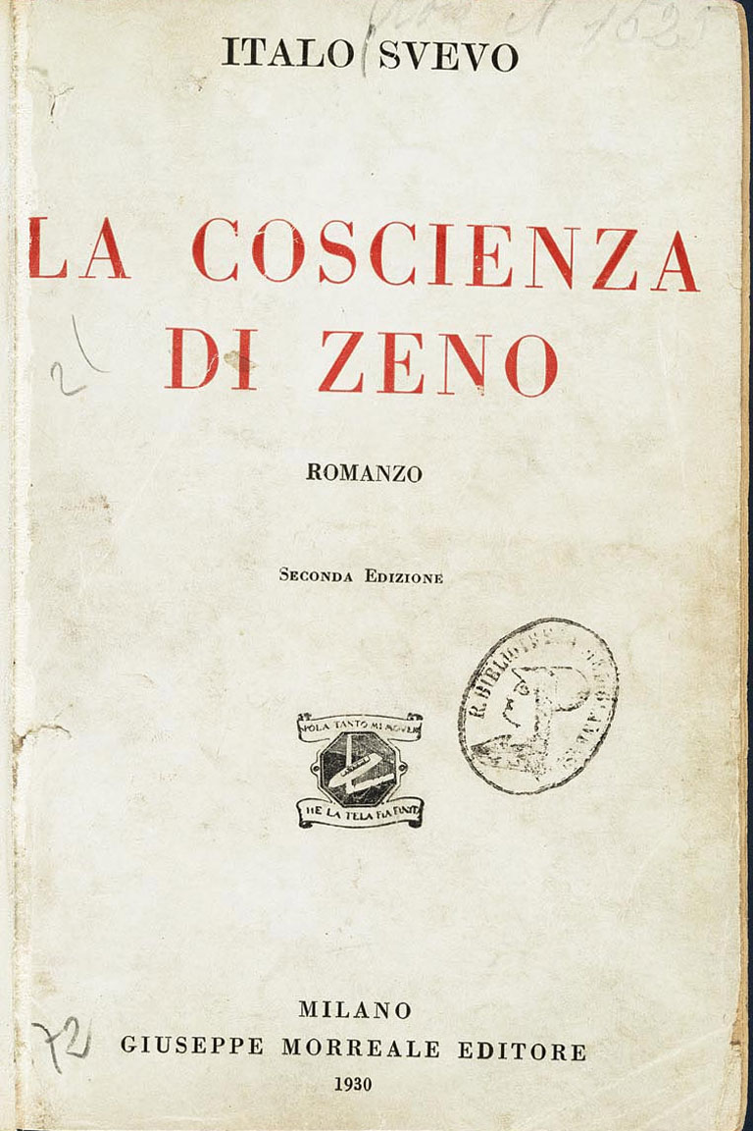
Computing priors
13 italian books
12 norwegian books
9 english books

Slide 25
Computing priors
Only based on the library, what language is the book?
Total amount of books is 13 + 12 + 9 = 34

Slide 26
Computing priors
13 / 34 chance it is Italian, so 38%
12 / 34 chance it is Norwegian, so 35%
9 / 34 chance it is English, so 26%

Slide 27
Computing priors
self.__priors["Italian"] = 0.38
self.__priors["Norwegian"] = 0.35
self.__priors["English"] = 0.26

Slide 28
Computing priors
def __compute_priors(self, training_set) -> None:
# Find the total amount of entries in training_set
# Calculate the prior of each category
# Add { category: prior } to self.__priors

Slide 29
Computing priors
def __compute_priors(self, training_set) -> None:
# total = 34
# Calculate the prior of each category
# Add { category: prior } to self.__priors

Slide 30
Computing priors
def __compute_priors(self, training_set) -> None:
# total = 34
# prior = 13 / 34
# Add { category: prior } to self.__priors

Slide 31
Computing priors
def __compute_priors(self, training_set) -> None:
# total = 34
# prior = 13 / 34
# self.__priors["it"] = prior

Slide 32
"Priors"?
We call them "priors" because we haven’t looked at the mystery book’s contents yet!

Slide 33
Computing posteriors
def __compute_posteriors(self, training_set, fields):

Slide 34
Computing posteriors
We’d like our guesses to be a little more educated
Let’s look inside the books!

Slide 35
Computing posteriors
Our books are easy to read, they all contain max 5 words!
Informatikk, everyone, pasta, ciao, Norge

Slide 36
Computing posteriors

Slide 37

Computing posteriors
p( Informatikk | 🇮🇹 ) = 0 / 24 = 0
p( Everyone | 🇮🇹 ) = 4 / 24 = 0.17
p( Pasta | 🇮🇹 ) = 6 / 24 = 0.25
p( Ciao | 🇮🇹 ) = 13 / 24 = 0.54
p( Norge | 🇮🇹 ) = 1 / 24 = 0.04

Slide 38
Computing posteriors

Slide 39

Computing posteriors
p( Informatikk | 🇳🇴 ) = 11 / 23 = 0.48
p( Everyone | 🇳🇴 ) = 1 / 23 = 0.04
p( Pasta | 🇳🇴 ) = 6 / 23 = 0.26
p( Ciao | 🇳🇴 ) = 0 / 23 = 0
p( Norge | 🇳🇴 ) = 5 / 23 = 0.22

Slide 40
Computing posteriors

Slide 41

Computing posteriors
p( Informatikk | 🇬🇧 ) = 0 / 21 = 0
p( Everyone | 🇬🇧 ) = 9 / 21 = 0.43
p( Pasta | 🇬🇧 ) = 8 / 21 = 0.38
p( Ciao | 🇬🇧 ) = 4 / 21 = 0.19
p( Norge | 🇬🇧 ) = 0 / 21 = 0

Slide 42
Computing posteriors (it)
def __compute_posteriors(self, training_set, fields):
# Iterate each category and corpus in training_set
# Get all terms per category
# Add total term freq to self.__denominators
# Add { term: probability } to self.__conditionals

Slide 43
Computing posteriors (it)
def __compute_posteriors(self, training_set, fields):
# Iterate each category and corpus in training_set
# Everyone⁴, Pasta⁶, Ciao¹³, Norge¹
# Add total term freq to self.__denominators
# Add { term: probability } to self.__conditionals

Slide 44
Computing posteriors (it)
def __compute_posteriors(self, training_set, fields):
# Iterate each category and corpus in training_set
# Everyone⁴, Pasta⁶, Ciao¹³, Norge¹
# self.__denominators["It"] = 24
# Add { term: probability } to self.__conditionals

Slide 45
Computing posteriors (it)
def __compute_posteriors(self, training_set, fields):
# Iterate each category and corpus in training_set
# Everyone⁴, Pasta⁶, Ciao¹³, Norge¹
# self.__denominators["It"] = 24
# self.__conditionals["it"] = { everyone : 4/24 } # self.__conditionals["it"] = { pasta : 6/24 } # self.__conditionals["it"] = { ciao : 13/24 } # self.__conditionals["it"] = { norge : 1/24 }

Slide 46
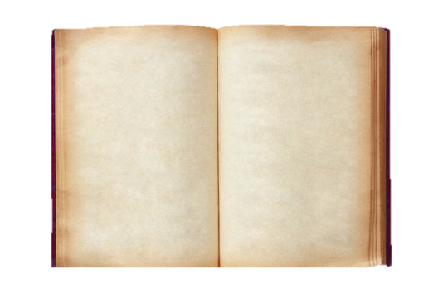
Computing posteriors
Time to check out the mystery book!
Ciao everyone!
- Pasta

Slide 47
Computing posteriors
self.__priors["Italian"] = 0.38
p( Ciao | 🇮🇹 ) = 0.54
p( Everyone | 🇮🇹 ) = 0.17
p( Pasta | 🇮🇹 ) = 0.25

Slide 48
Computing posteriors
Italian probability = 0.38 x 0.54 x 0.17 x 0.25 = 0.0087

Slide 49
Computing posteriors
self.__priors["Norwegian"] = 0.35
p( Ciao | 🇳🇴 ) = 0
p( Everyone | 🇳🇴 ) = 0.04
p( Pasta | 🇳🇴 ) = 0.26

Slide 50
Computing posteriors
Norwegian probability = 0.35 x 0 x 0.04 x 0.26 = 0

Slide 51
Computing posteriors
self.__priors["English"] = 0.26
p( Ciao | 🇬🇧 ) = 0.19
p( Everyone | 🇬🇧 ) = 0.43
p( Pasta | 🇬🇧 ) = 0.38

Slide 52
Computing posteriors
English probability = 0.26 x 0.19 x 0.43 x 0.38 = 0.008

Slide 53
And the winner is…
Italian probability = 0.38 x 0.54 x 0.17 x 0.25 = 0.0087
English probability = 0.26 x 0.19 x 0.43 x 0.38 = 0.0080
Norwegian probability = 0.35 x 0 x 0.04 x 0.26 = 0.0000

Slide 54
Today’s Agenda
The trip to and from Toronto!
Naive Bayes walkthrough + Assignment E
Book of the week

Slide 55

book of the week
Maskiner som tenker
Inga Strümke
Why?
Curious pessimism
Inga Strümke was funny on Nytt på Nytt

Slide 56
Today’s Agenda
The trip to and from Toronto!
Naive Bayes walkthrough + Assignment E
Book of the week

